Slide 1
Welcome to Ultimate Web Design

Slide 2
Let us tell you about our offered services.
Ultimate Web Designs Limited is one of the best digital media marketing agency based in Auckland, NZ. Here is the list of services offered by Ultimate Web Design:-
Digital Marketing Consultants
Wordpress Websites
Custom CMS Website Development
E-Commerce Website Development
Search Engine Optimization
Responsive Web Design & Development
Mobile App Development
Custom Software Development
Game Development
Social Media Marketing
Mobile Marketing
Graphic Design

Slide 3
We provide many of result-oriented services with great customer experience quality. Our Digital Marketing Consultants will help you understand the market and create a profitable marketing strategy that will help you understand your potential customers in a better way. More services will be described in next slides.

Slide 4
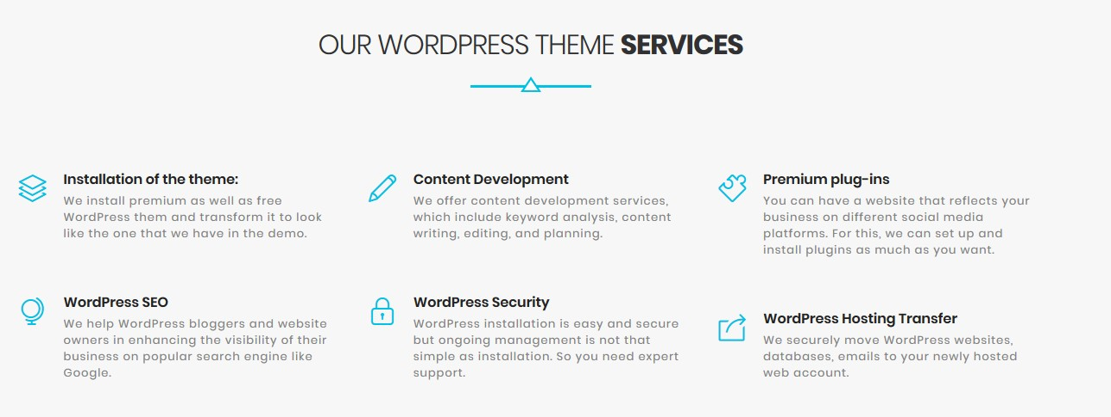
B. Wordpress Website Design & Development
Bring your most daring ideas to life with a professional WordPress web designer. From custom designs to migrations and malware removal, we can do it all when it comes to WordPress design and development. Find out how at our webpage - Affordable Business Websites in Auckland.

Slide 5
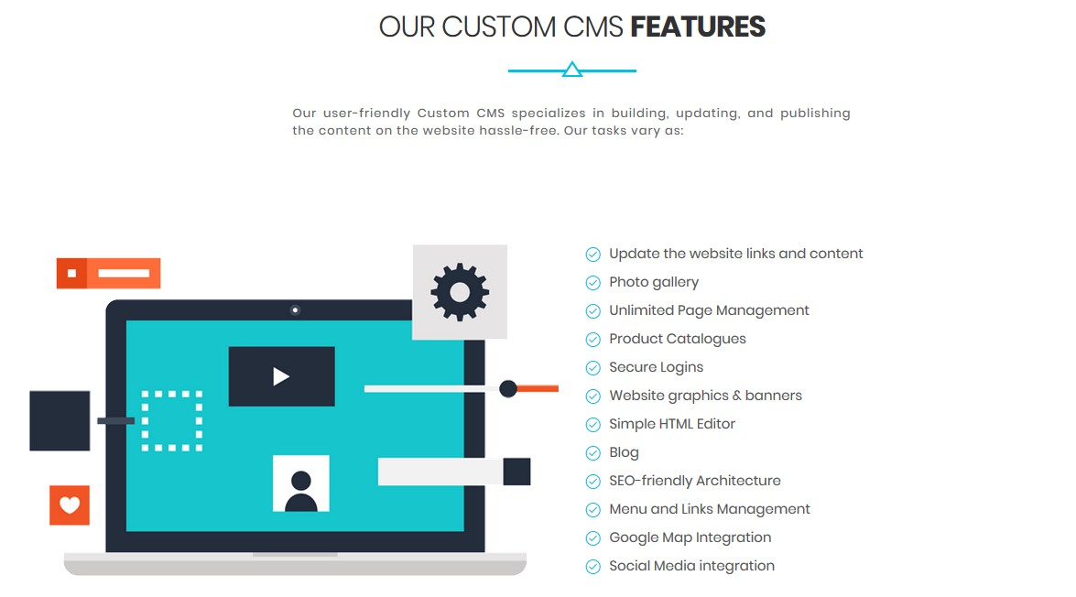
C. Custom CMS Website Development
Whether you need to establish a new web presence or redesign your current website, you need to have a content management system (CMS) for maintaining and updating your digital content. We build custom CMS websites for different businesses tailored to the specific requisites.

Slide 6
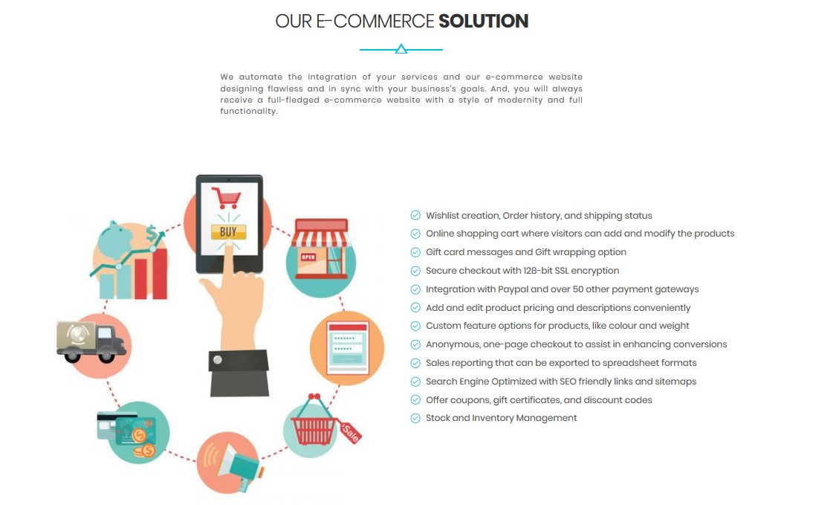
D. E-Commerce Website Development
E-commerce web development has become a requirement as it is very important to enhance the level of traffic. We at Ultimate Web Designs are one the best web design agencies specializing in E-Commerce all across the New Zealand.

Slide 7
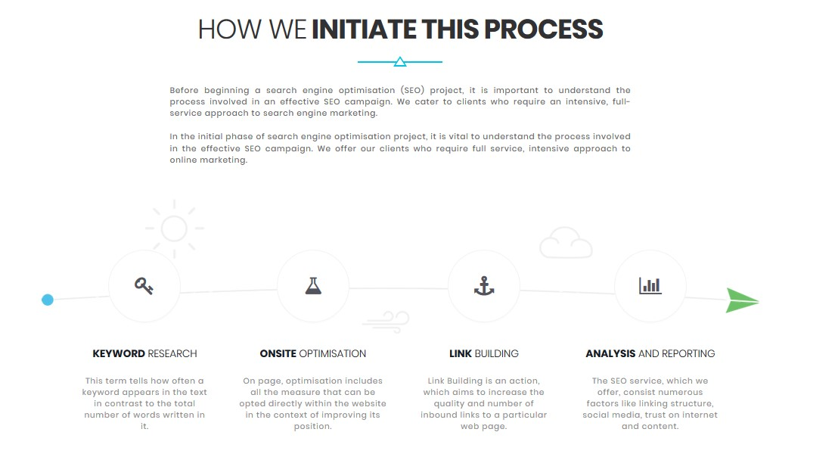
E. Search Engine Optimization
Ultimate Web Designs Limited works to increase online traffic and search engine ranking of a website. The proficiency acquired by our copywriting and technical staff makes us capable to cater demands of different companies.

Slide 8
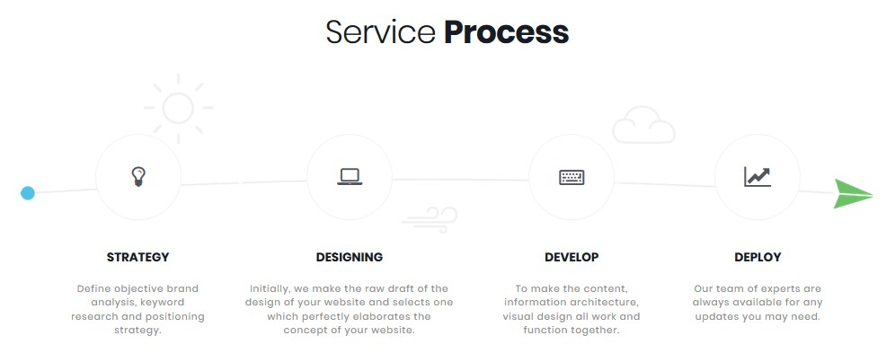
F. Responsive Web Design & Development
Responsive web design (RWD) is an approach to web design which makes web pages render well on a variety of devices and window or screen sizes.
A responsive design ensures your website will adapt onsite content, images, and functionalities for mobile, tablet, and desktop devices.
Ultimate Web Designs is the most recommended Web Development and Web Design Company based in Auckland, NZ. Our web design page includes variety of services offered and affordable pricing plans at - Responsive Website Design Services in Auckland, NZ.

Slide 9
So these were a few services offered by Ultimate Web Designs; Best IT Solutions and Web Design service provider company in Auckland, NZ.
In our next slideshow, we will display our more exciting services & our perspective of work.
To know our story or about our services you can check our about us page–
https://ultimatewebdesigns.co.nz/about-us/

Slide 10
www.ultimatewebdesigns.co.nz
Address:
Unit L, Building 3, 100 Bush Road, Albany, AUCKLAND 0632
Phone:
021 035 7909
Email:
info@ultimatewebdesigns.co.nz

